Slide 1
The use of gas laws in cars
By Kevin Doty

Slide 2
What is this?
Gas Laws are “laws” found in the Kinetic Molecular Theory that all gases follow in Thermochemistry and are made up of 6 different Gas laws:
Boyle’s Law → Change in Pressure/Volume
Charles’s Law → Change in Volume/Temperature
Gay-Lussac’s Law → Change in Pressure/Temperature
Dalton’s Law of Partial Pressures
Combined Gas Law → Change in Pressure/Volume/Temperature
Ideal Gas Law → PV=nRT
Avogadro’s Principle → “equal volumes of all gases, at the same temperature and pressure, have the same number of moles”
Notes:
Avogadro: for a given mass of an ideal gas, the volume and amount (moles) of the gas are directly proportional if the temperature and pressure are constant

Slide 3
Some Standards background
Standards:
CHEM.B.2.2.1: Utilize mathematical relationships to predict changes in the number of particles, the temperature, the pressure, and the volume in a gaseous system (i.e. the 6 gas laws)
CHEM.B2.2.2: Predict the amounts of reactants and products involved in a chemical reaction using molar volume of a gas at STP

Slide 4
For our usage, we are going to only focus on a few of them right now as it pertains to cars
I should mention that these laws are experimental laws, and thus certain variables must also be held at constant to really understand relationships between the existing variables involved.

Slide 5
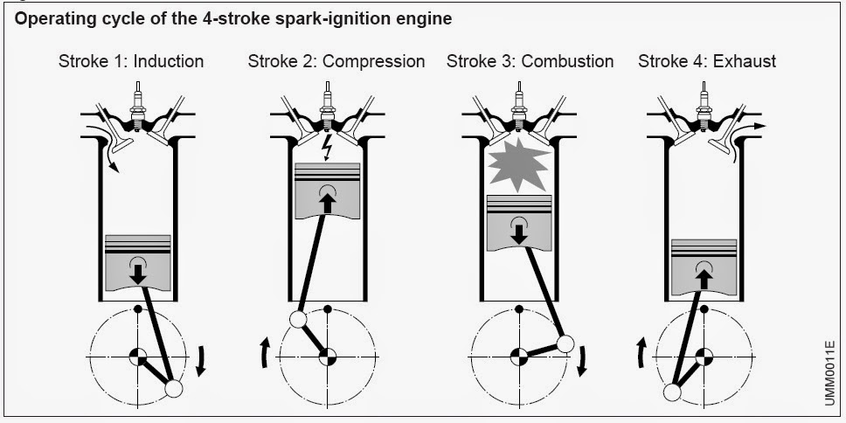
Background into the laws
Boyle’s Law:
Difference between pressure and volume (for this explanation, we will assume that the combustion chamber is filled with air/gas)
Pressure Increases = Volume Decreases
Notes:
What is this saying? Considering you are all experts on cars no doubt, I’m sure you all have some background in how an engine works, especially a spark ignition engine, which utilizes Boyle’s Law of the inverse relationship between pressure and volume. While the compression stroke is taking place, the piston moves upwards and therefore compresses the air-fuel mixture of different particles (because we all know oxygen is required for a combustion reaction). With the piston moving upward compressing air within the cylinder, this will decrease (#2) the volume and increase the pressure of the gas, allowing for more collisions between the atomized fuel and the air particles, which then causes a combustion and ignition.

Slide 6
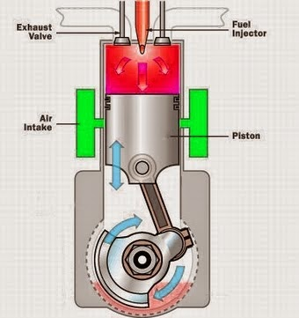
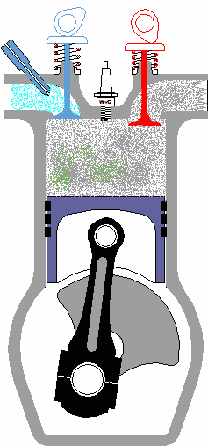
Charles’s Law
This law uses the relationship between volume and temperature (given that the pressure will be held constant)
Temperature Increases = Volume Increases
Focuses on the power strokes of spark ignition (petrol) and compression ignition (diesel)
Notes:
As you all know, combustion reactions within engines themselves are exposed to incredibly high temperature; this increase in temperature causes an expansion of the gas inside of the engine. This expansion of volume pushes against the cylinder and piston head, which then rotates the crankshaft as it transfers the force of the expansion.
Compression ignition (diesel engines) compresses the air intake, which in turn increases the temperature (it should be stated that temperature is the more rapid movement of particles). Diesel fuel is injected into the cylinder, combining with the now heated air and causes the diesel fuel to ignite.
In general, Charles’s Law applies to the movement of the crankshaft in both petrol and diesel engines.

Slide 7
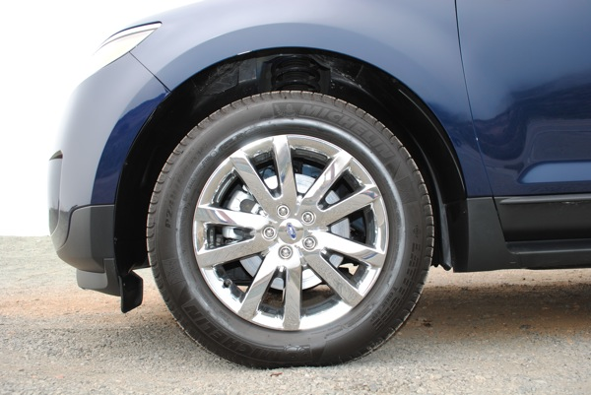
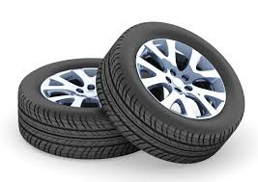
Gay-Lussac’s Law
Relationship between Pressure and Temperature
Temperature Increases = Pressure Increases
Where does this Law apply?
TIRES!!
Flexing of the tire as you drive inevitably raises the temperature of the air in the tire = pressure of the gas increases.

Slide 8
The unit that I created includes:
6 Lesson Plans that each talk about a different Gas Law
What the students will KNOW by the end of this unit
What the students will be able to DO by the end of this unit
2 Benchmark assignments
1 Performance Task with a rubric
1 Unit Test incorporating everything that they now know

Slide 9
Performance task
Research and choose a car from the AACA website that was made after 1898.
Find and determine different parts of the car that incorporate the ideal gas laws.
How do those parts use the laws? What laws do they use? Include what type of systems they are.
Create a PowerPoint, poster, Prezi, or another accepted form of assessment to hand in

