Slide 1
Linear Equations and Graphing

Slide 2
Solutions to Equations
A solution of an equation is an _________________$(x,y)$ that makes a true statement when the values for x and y are substituted into the equation
Which ordered pair is a solution to $3x−y=7$?
a) $(3,4)$ b) $(1,−4)$ c) $(5,−3)$ d) $(−1,−2)$

Slide 3
Slope-intercept Form
Slope-intercept form is when we have an equation that has the form: $y=mx+b$
m is the slope
b is the y-intercept

Slide 4
Practice
What is the slope and y-intercept of the following equations?
$y=−2x−4$
$y=5x+8$
$y=−\frac{1}{2}x+7$

Slide 5
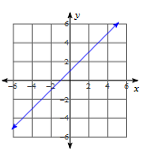
Given a graph, what are the slope and intercept?

Slide 6
Graphing Equations
When we graph, we plot __________.
Plot the easy points: Use -1, 0, and 1!
To finish, we just connect the points.

Slide 7
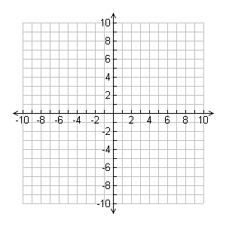
Graph the equation: $y=3x+1$

