Slide 1
Unit Rates

Slide 2
Warm Up
Create and solve a proportion:
If Tommy drives 50 miles in 60 minutes and continues at the same speed, how long will it take him to travel 225 miles?
Jessica pays $22.03 for 9.5 gallons of gas to fill up her car. Johns truck holds 15 gallons. How much will it cost him to fill up his tank?

Slide 3
Definition of Unit Rate
Unit Rate: The ratio of two measurements in which the second term is 1.
Example: $2.34 : 1 gallon

Slide 4
Example Problems
Elizabeth purchases 15.2 gallons for $40.28 at Wawa. How much does 1 gallon of gas cost?
John purchases 11.25 gallons for $31.50 at Sheetz. How much does 1 gallon of gas cost?
Which gas station has the cheaper gas?

Slide 5
Example Problems Continued
Maria’s car can hold 12 gallons of gas. She can travel 372 miles before she runs out of gas. How many miles can she travel on one gallon of gas?
Ryan drove to his grandparents house which is 168 miles away. It took him 3.5 hours to get there. How fast was he going in miles per hour?

Slide 6
Sheetz or no Sheetz
Should you go to Sheetz or Speedway?
Gabbi bought gas at Sheetz for $21.74 and got 11.5 gallons.
Bobby bought gas at Speedway for $29.25 and got 15 gallons.

Slide 7
Sheetz or no Sheetz
Should you go to Sheetz or Speedway?
Ashley bought gas at Sheetz for $45.58 and got 21.2 gallons.
Andrew bought gas at Speedway for $37.21 and got 17.55 gallons.

Slide 8
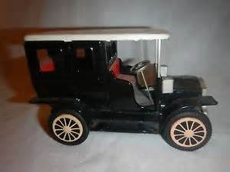
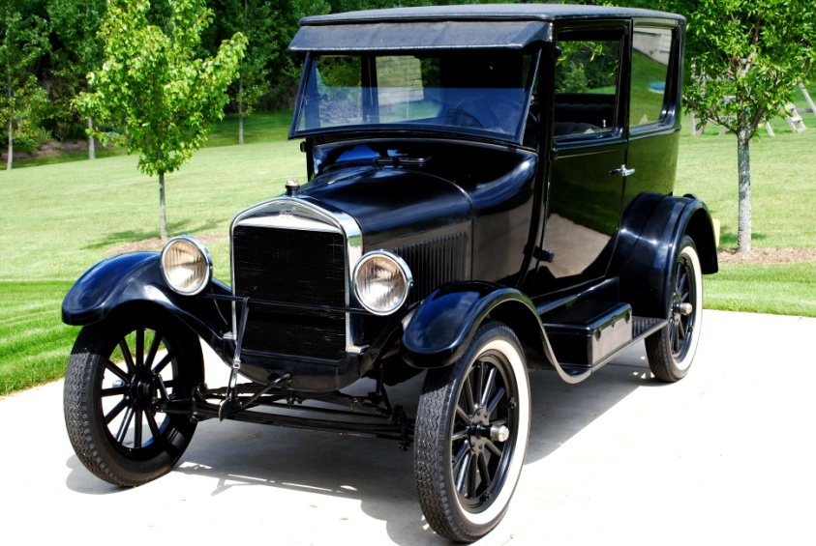
The toy Ford Model T is 6 inches long.
The Ford Model T is 144 inches long.
Find the unit rate between the real car and the toy car.

Slide 9
Using the unit rate from the previous slide, find the dimensions of the real car if these are the dimension for the toy car:
Height = 5 inches
Width = 4.5 inches
Wheel diameter = 1 inch

