Slide 1
Are we too materialistic?
Try to guess what product or company the following slogans match up to. You might be surprised by what you know, or rather, are conditioned to know.
All images from Google Images

Slide 2
“Built ____ Tough”
Ford

Slide 3
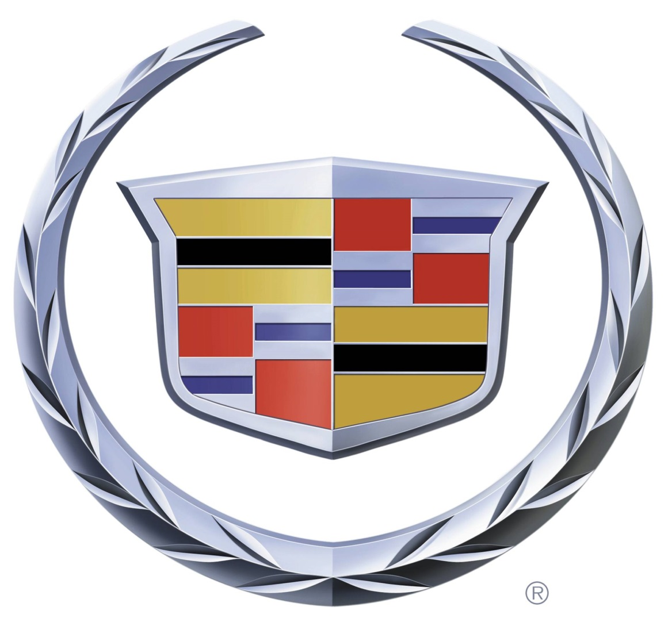
Cadillac

Slide 4
“Love. It’s what makes a ____ a _____”
Subaru

Slide 5
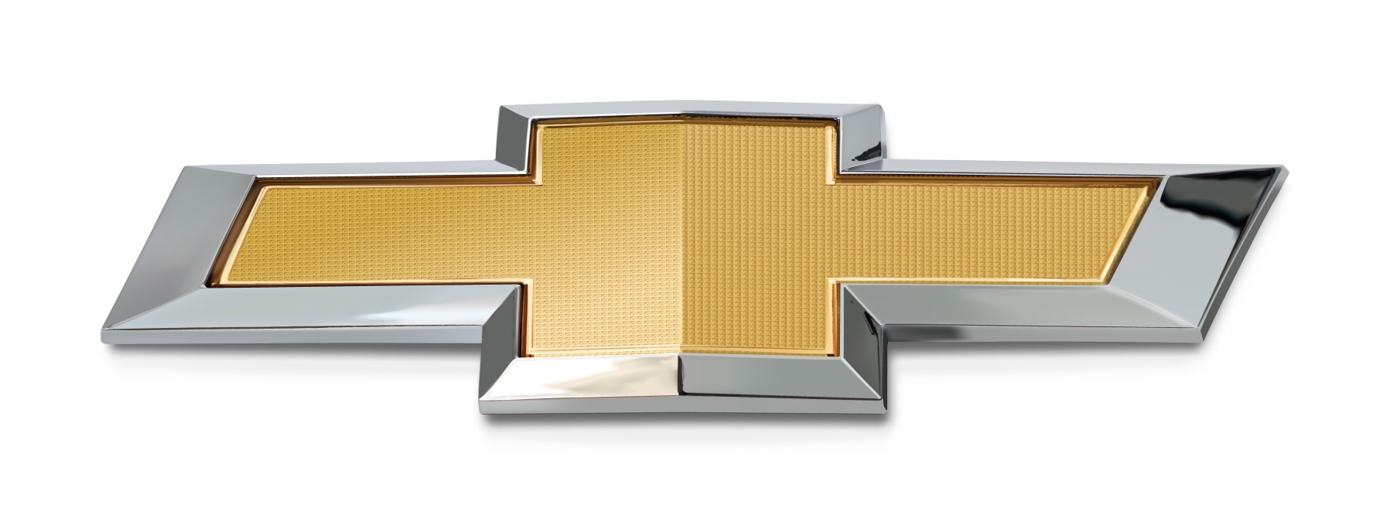
Chevrolet

Slide 6
“Unlike any other”
Mercedes-Benz

Slide 7
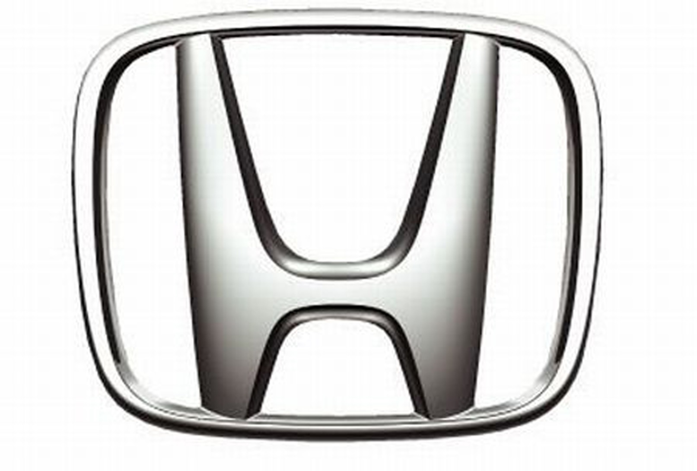
Honda

Slide 8
“Let’s go places”
Toyota

Slide 9
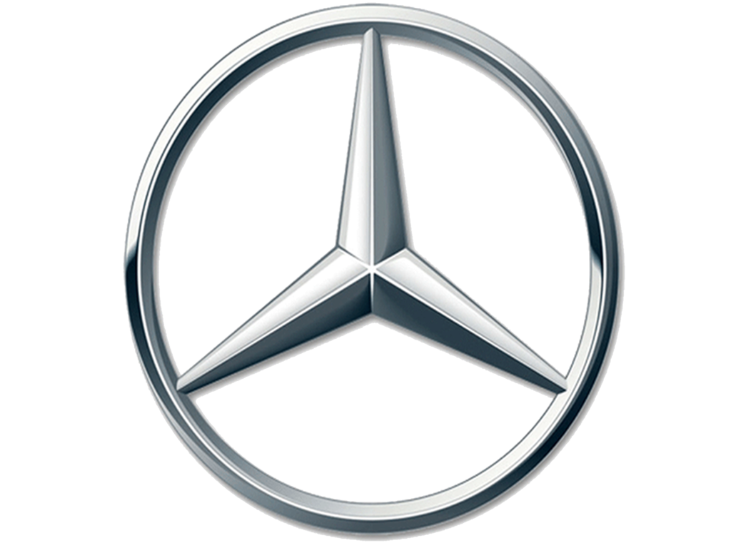
Mercedes-Benz

Slide 10
“Grab life by the horns”
Dodge

Slide 11
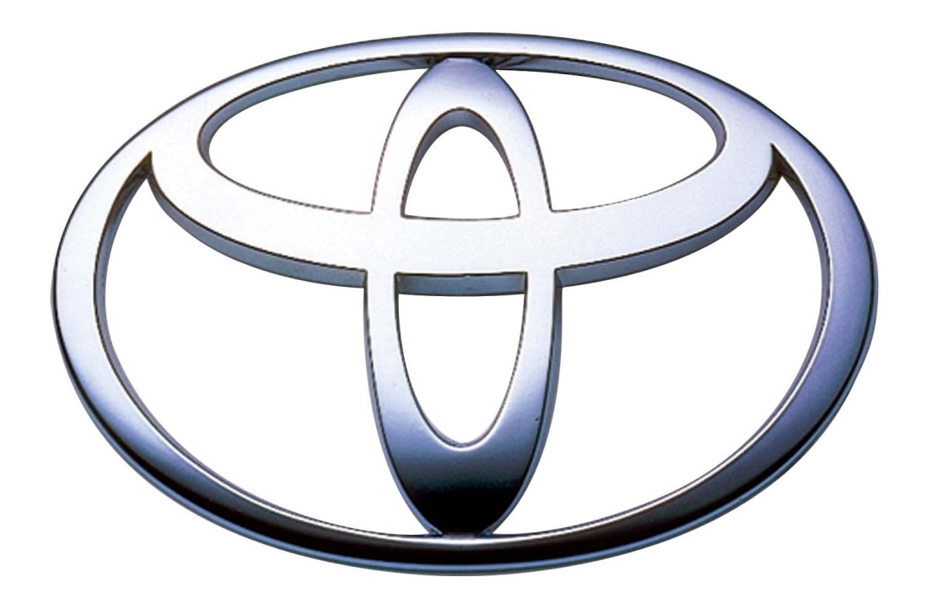
Toyota

